Slide 1
Name
Institution
Date
Engineering

Slide 2
Voice recognition
Voice recognition is a machine or a program ability to receive and interpret or to understand and carry out commands which are spoken.
The systems of voice recognition have enabled many consumers by simply speaking to interact with technology.
Prominence and use of voice recognition with AI and intelligent assistants have increased. For example Cortana by Microsoft, Siri by Apple, and Alexa by Amazon.
Voice recognition systems also enables requests which are hands-free, reminders and other tasks which are simple.

Slide 3
Signal processing
Signal processing is described as the process where relevant information from a voice signal is extracted in a manner that is robust and efficient.
In voice recognition, signal processing helps in conversion of a signal that is acoustic and captured by a microphone or a telephone and then to a set of words.

Slide 4
How voice recognition works
For voice recognition to work, analog audio must be converted into a digital signal which is called analog-to-digital conversion.
A digital database, or vocabulary of either words or syllables with a speedy means to compare data signals must be in a computer for it to decipher a signal.
The hard drive stores the speech patterns and when the program is run, it is loaded into the memory.
Although this technology of voice recognition originated on PCs, it has gained an acceptance both in consumer spaces and business.

Slide 5
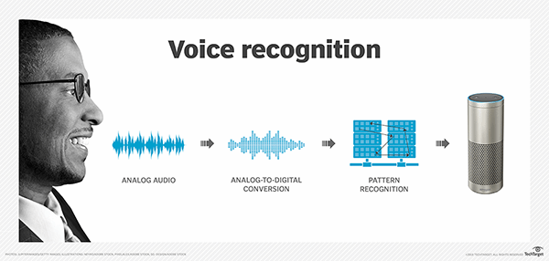
Continuation
The below figure illustrates a voice recognition technology.

Slide 6
Why voice recognition
An alternative to typing can be provided by voice recognition.
For disabled people who are unable to use a mouse or keyboard, voice recognition provides a world of productive possibilities.
Reduces the risk of repetitive strain injury caused by excessive typing or use of mouse.
Voice recognition when used by employers in the workplace can be an adjustment which is reasonable as it will prevent discrimination and maximize disabled staff productivity. (Pearl, 2017)

Slide 7
When to use voice recognition
Voice recognition is commonly used wile operating a device, performing commands, and writing without using a mouse, keyboard or any buttons.
In the digital world today, voice recognition is done on a computer which has automatic speech recognition (ASR) programs software. (Pearl, 2017)

Slide 8
References
Ramírez, J., & Górriz, J. M. (2011). Recent advances in robust speech recognition technology. Place of publication not identified: Bentham Science Publishers.
Pearl, C. (2017). Designing voice user interfaces: Principles of conversational experiences.

